Slide 1
Robust Estimation: TRuncatEd, Approximated, and Tightness
Liangzu Peng (lpeng25@jhu.edu)
Johns Hopkins University
Vision Lab Retreat, September 9, 2022

Slide 2
RETREAT
Semidefinite Relaxations of Truncated Least-Squares in Robust Rotation Search: Tight or Not
ECCV 2022
Liangzu Peng, Mahyar Fazlyab, René Vidal
Keywords: Robust Estimation, TRuncatEd, Tightness
ARCS: Accurate Rotation and Correspondences Search
CVPR 2022
Liangzu Peng, Manolis C. Tsakiris, René Vidal
Keywords: Robust Estimation, Approximated
A different and more honest title:
“Rotation Search: Theory and Algorithms”

Slide 3
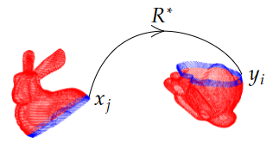
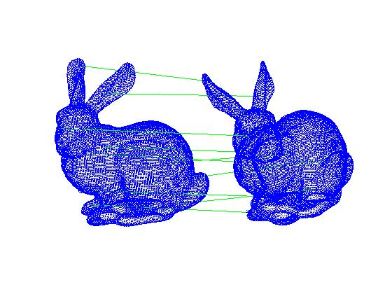
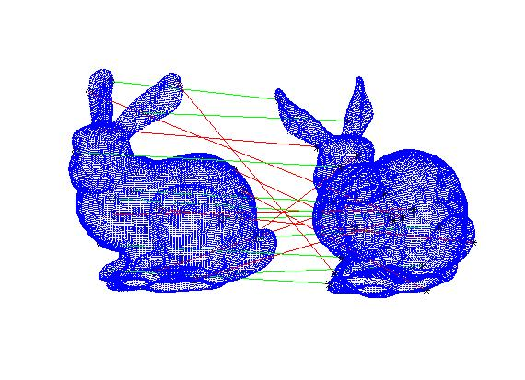



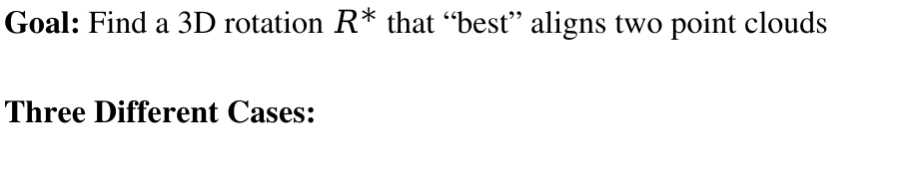
Rotation Search: Problem Setup
Goal: Find a 3D rotation $R^{∗}$ that “best” aligns two point clouds
Three Different Cases:
(2) With Outliers
(3) Correspondence-Less
(Partially Overlapped)
(1) Outlier-Free
$$y_{i}≈R^{∗}x_{i}$$
for all $i$
$$y_{i}≈R^{∗}x_{i}$$
for some $i$
$$y_{i}≈R^{∗}x_{j}$$
for some $(i,j)$

Slide 4
Part I: Theory
Semidefinite Relaxations of Truncated Least-Squares in Robust Rotation Search: Tight or Not
ECCV 2022
Liangzu Peng, Mahyar Fazlyab, René Vidal

Slide 5
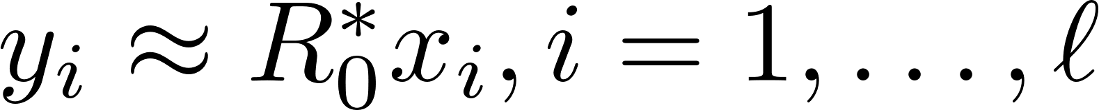

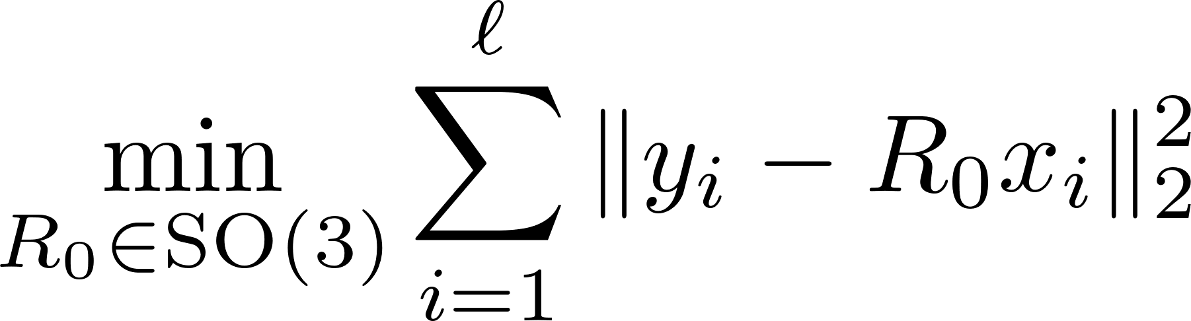
The Outlier-Free Case
Wahba’s Problem
(Wahba, 1965)
G. Wahba. A least squares estimate of satellite attitude.
SIAM Review, 1965

Slide 6
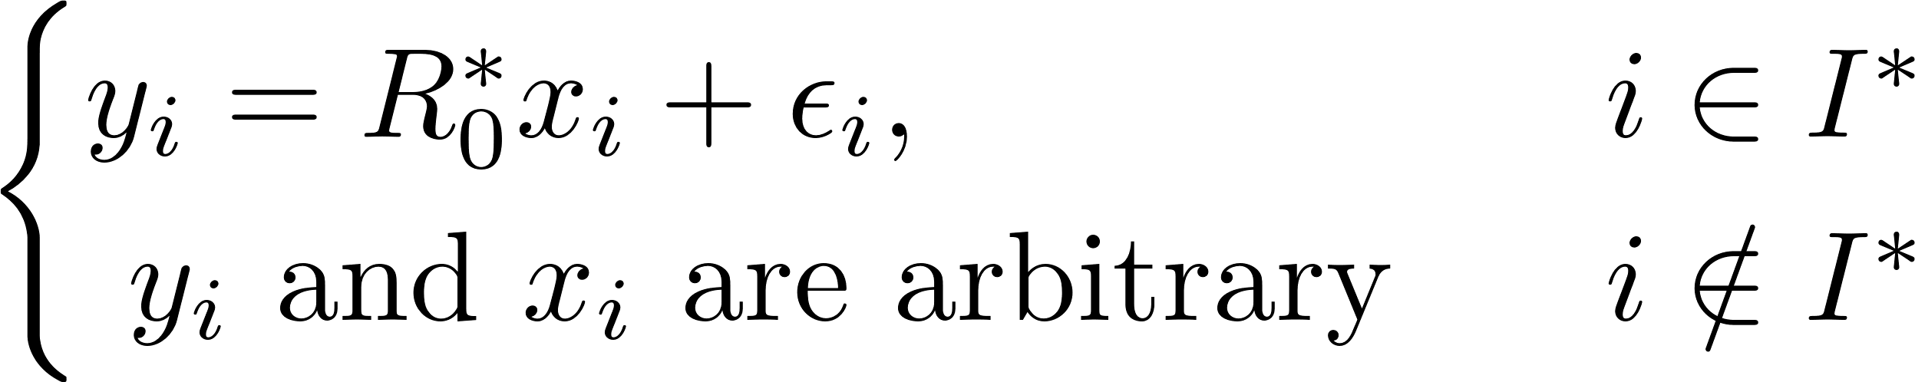
(Outlier-)Robust Rotation Search

Slide 7
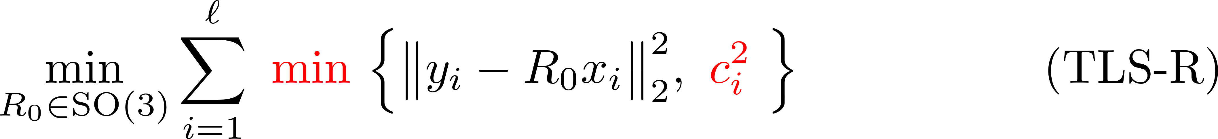
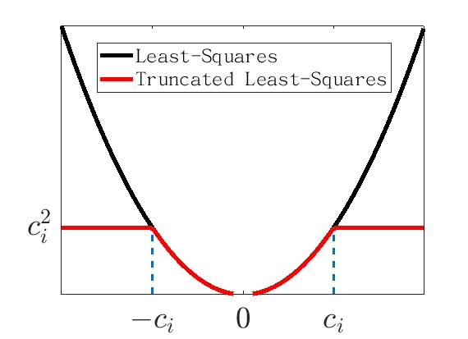
Truncated Least-Squares (Rotation)
(Huber, 1964)
H. Yang and L. Carlone. A quaternion-based certifiably optimal solution to the Wahba problem with outliers. ICCV 2019.

Slide 8
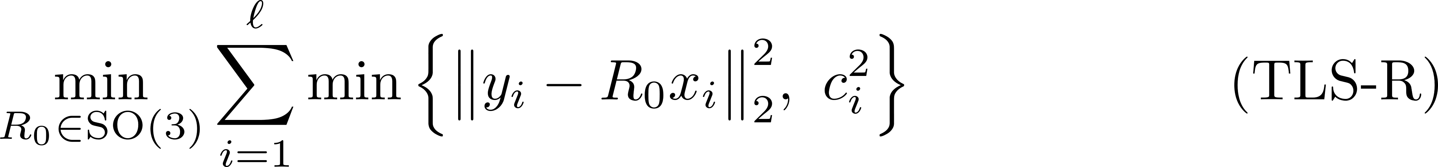
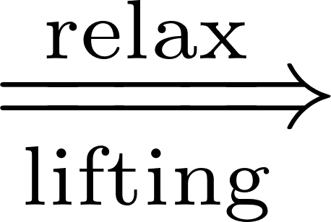

Overview 1/2
1. From (TLS-R) to Its Semidefinite Relaxations
We will derive (based on Yang & Carlone [1]):
(TLS-R) (TLS-Q) (QCQP) (SDR)
Rotation “replaced” by Unit Quaternion
[1] H. Yang and L. Carlone. A quaternion-based certifiably optimal solution to the Wahba problem with outliers. ICCV 2019.

Slide 9

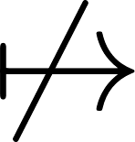
Overview 2/2
2. Tightness of (SDR): mi casa es su casa?
(TLS-R) (TLS-Q) (QCQP) (SDR)
We provide conditions, under which:
global minimizer of (SDR) global minimizer of (QCQP)
or equivalently (SDR) is tight or not
L. Peng, M. Fazlyab, R. Vidal, Semidefinite relaxations of truncated least-squares in robust rotation search: Tight or not, ECCV 2022

Slide 10

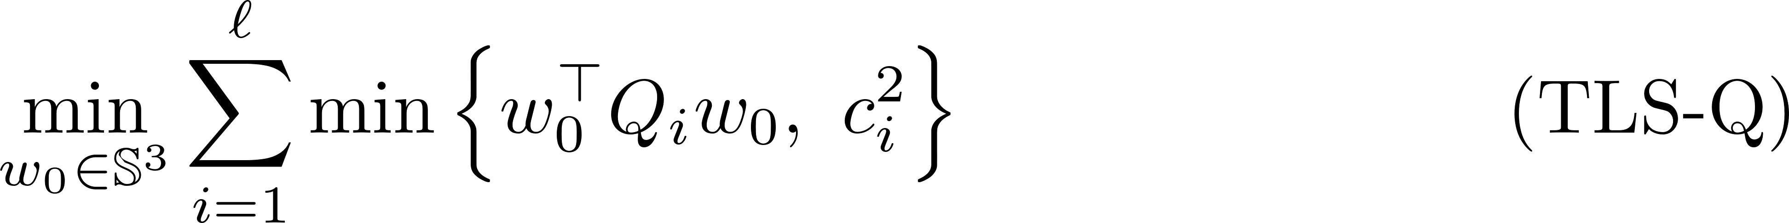

From (TLS-R) to (TLS-Q)
(TLS-R) (TLS-Q) (QCQP) (SDR)
Key Idea:
Change of
Optimization
Variables
Change of Data and Residual

Slide 11
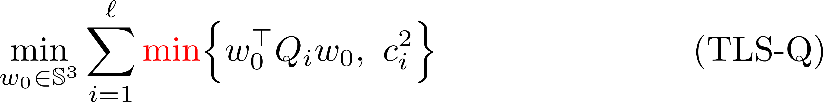
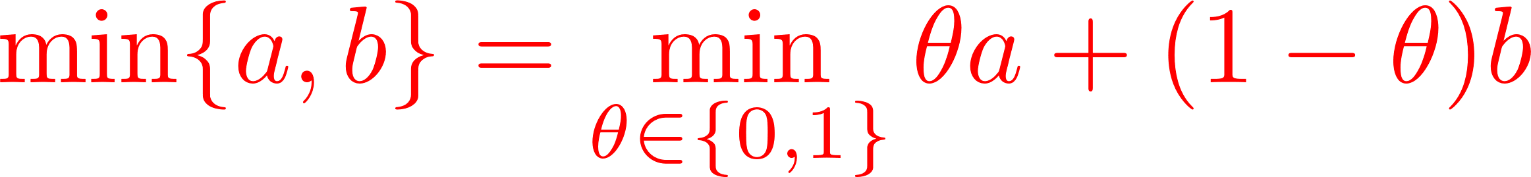
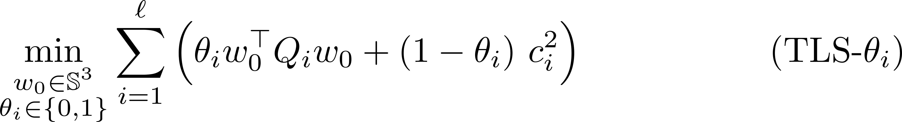
From (TLS-Q) to (QCQP) 1/4
(TLS-R) (TLS-Q) (QCQP) (SDR)
cubic polynomial in entries of the unknowns

Slide 12
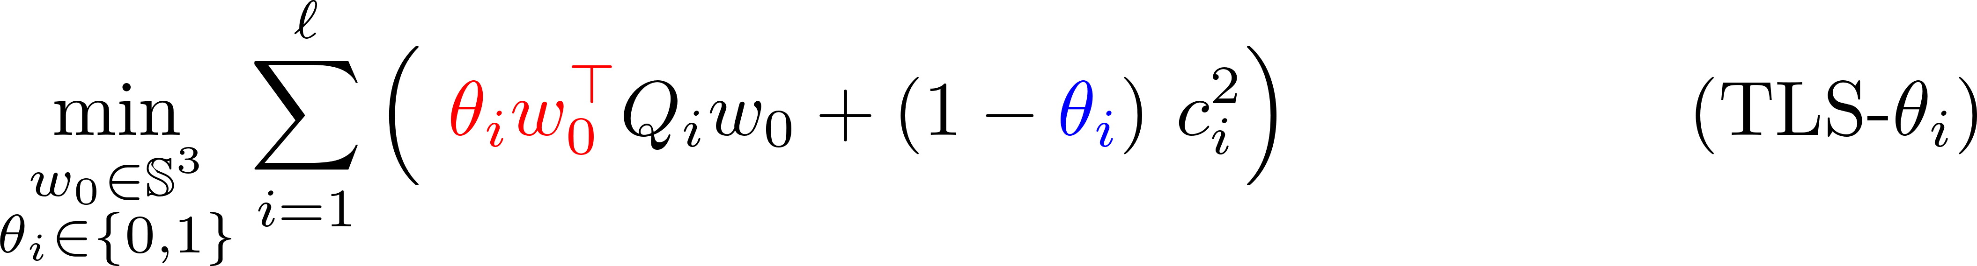
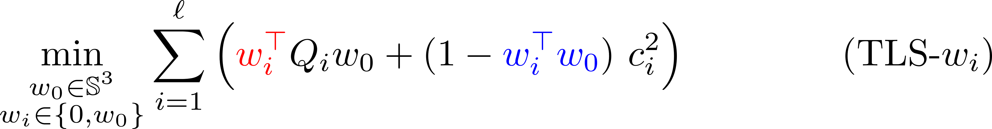
From (TLS-Q) to (QCQP) 2/4
(TLS-R) (TLS-Q) (QCQP) (SDR)
Quadratic Obj.
[1] H. Yang and L. Carlone. A quaternion-based certifiably optimal solution to the Wahba problem with outliers. ICCV 2019.

Slide 13
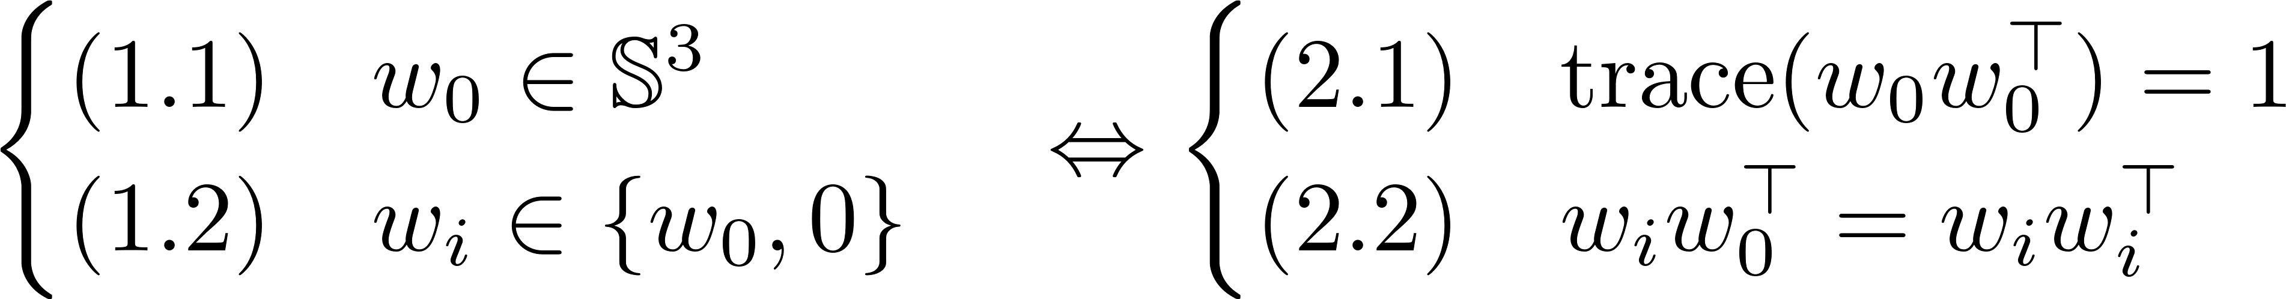
From (TLS-Q) to (QCQP) 3/4
(TLS-R) (TLS-Q) (QCQP) (SDR)
Quadratic Obj.
Constraints are also quadratic:

Slide 14
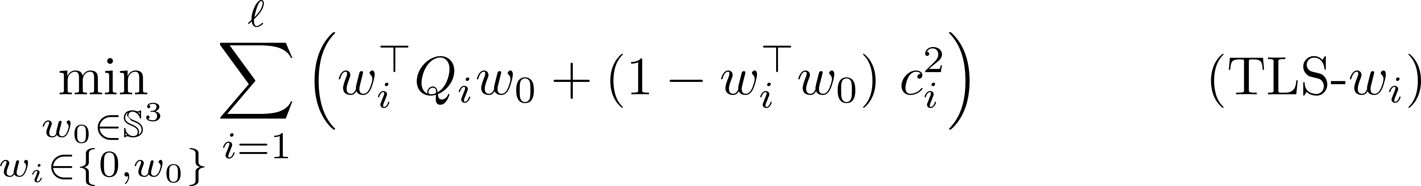
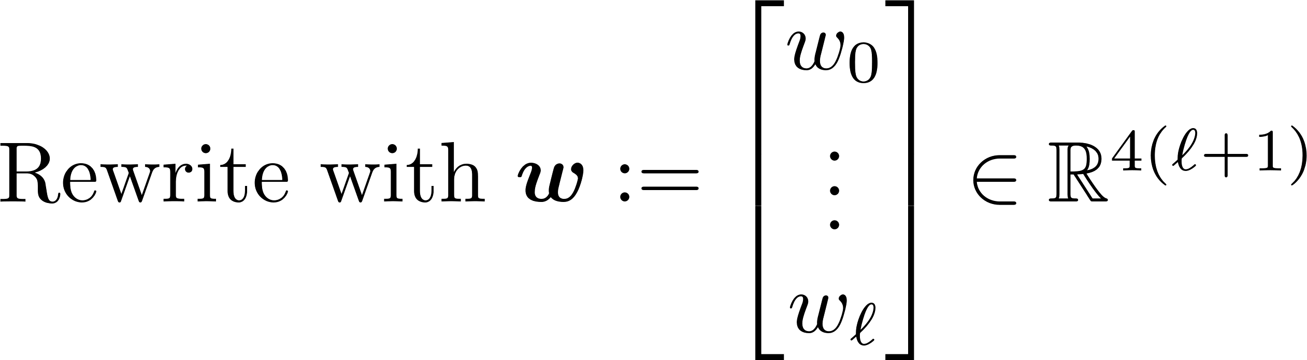
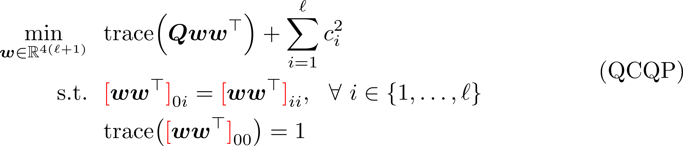
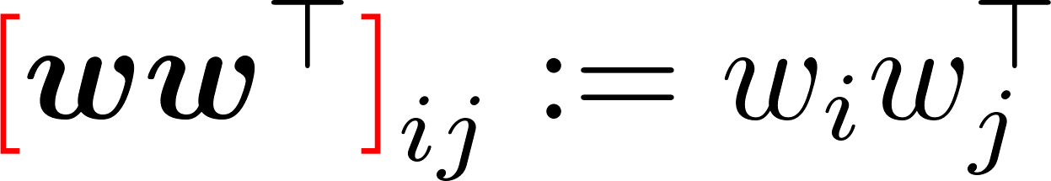
From (TLS-Q) to (QCQP) 4/4
(TLS-R) (TLS-Q) (QCQP) (SDR)

Slide 15

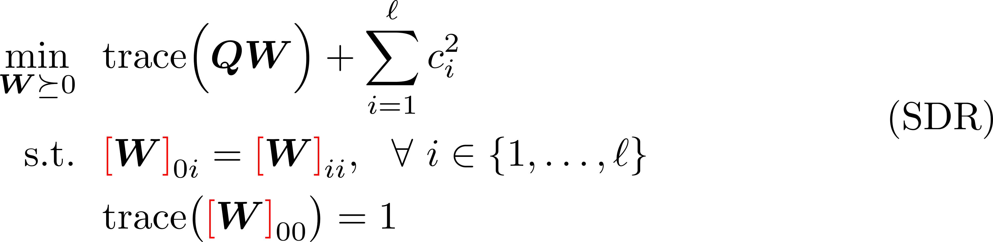
From (QCQP) to (SDR)
(TLS-R) (TLS-Q) (QCQP) (SDR)
Lifting

Slide 16
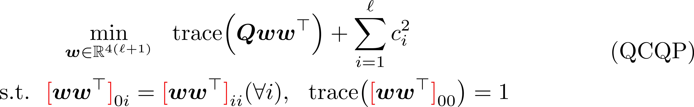
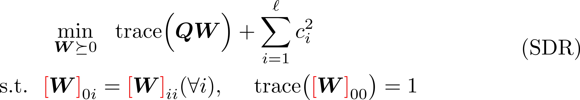
Tightness of (SDR) 1/5
Definition (Tightness, mi casa es su casa):
(TLS-R) (TLS-Q) (QCQP) (SDR)

Slide 17
Tightness of (SDR) 2/5
Structure of Our Theorems:
(TLS-R) (TLS-Q) (QCQP) (SDR)
Theorem 2
without noise
with outliers
Theorem 1
without noise
without outliers
Theorem 4
with noise
with outliers
Theorem 3
with noise
without outliers

Slide 18



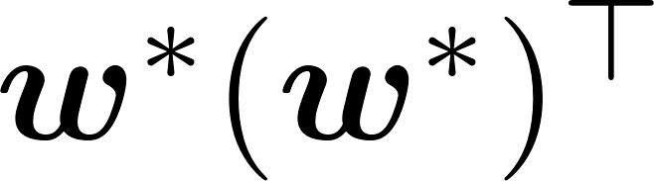
Tightness of (SDR) 3/5
Theorem 1:
(TLS-R) (TLS-Q) (QCQP) (SDR)
Ground-Truth:
Compared to [1], our proof is simpler and shorter.
[1] H. Yang and L. Carlone. A quaternion-based certifiably optimal solution to the Wahba problem with outliers. ICCV 2019.

Slide 19
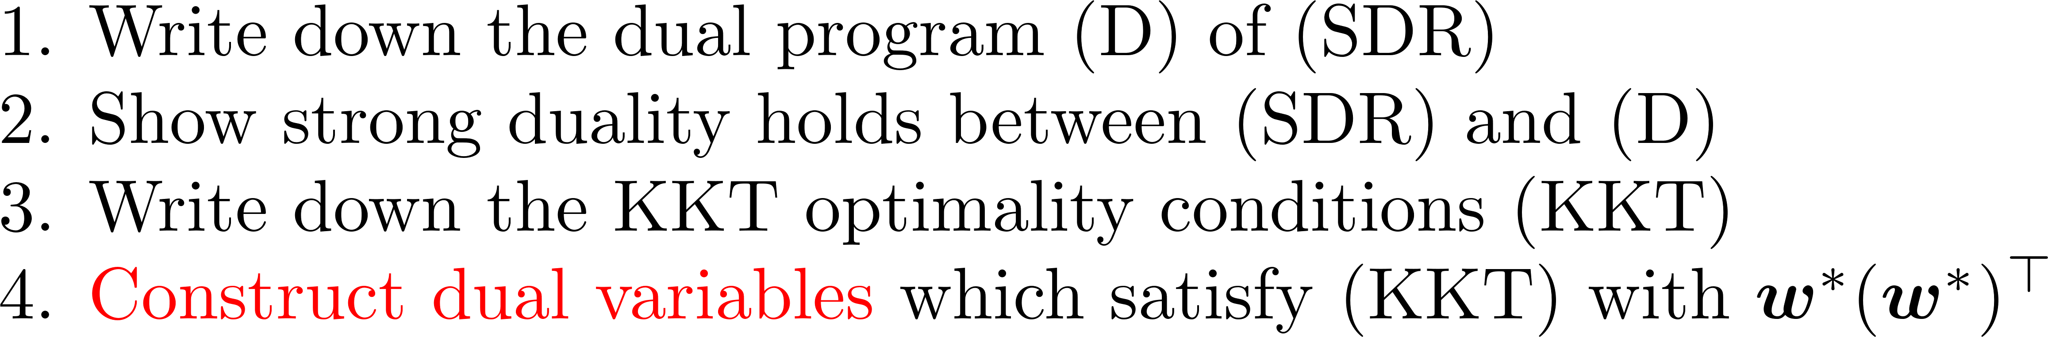
Tightness of (SDR) 4/5
Theorem 1:
(TLS-R) (TLS-Q) (QCQP) (SDR)
Ground-Truth:
High-Level Proof Idea:
L. Peng, M. Fazlyab, R. Vidal, Semidefinite relaxations of truncated least-squares in robust rotation search: Tight or not, ECCV 2022

Slide 20
Tightness of (SDR)
The rest theorems (Informal): (SDR) is tight
for random outliers, but not for adversarial outliers
Theorem 2, without noise
for small noise
Theorem 3, without outliers
for small noise and random outliers
Theorem 4
These results are not perfect! Call for improvements!
The rest of the paper:
some propositions about geometry & probability

Slide 21
Future Works (Part I)
Analyze a tighter relaxation of robust rotation search
E.g. at the second relaxation order of the Lasserre hierarchy
Empirically very tight, little to none theoretical justification
Can Ben & Vidal’s algorithm be extended for solving (SDR)?
Empirically, rank of the global minimizer of (SDR) does not exceed 4
Can we derive a similar/computable certifier for local/global optimality?
Can we guarantee the meta algorithm terminates at rank = 4?
General Message:
Classic geometric vision is far from being well-understood from a theoretical point of view
Modern tools from optimization, probability are needed to do so

Slide 22
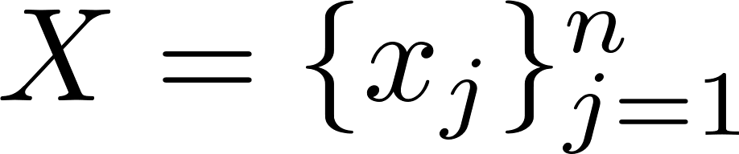
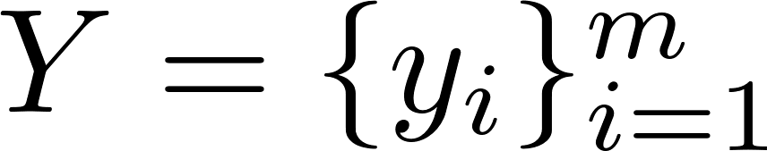
Part II: Algorithm
ARCS: Accurate Rotation and Correspondences Search
CVPR 2022
Liangzu Peng, Manolis C. Tsakiris, René Vidal
Correspondence-Less (Partially Overlapped)
additive noise
Goal:

Slide 23
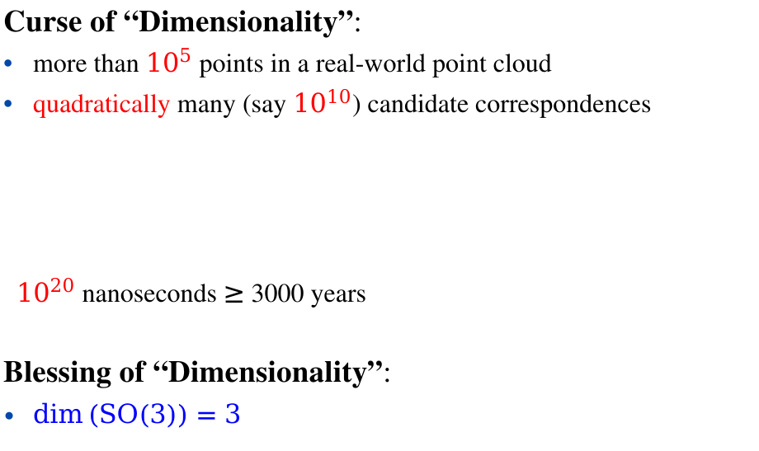
The Curse and Blessing
Curse of “Dimensionality”:
more than ${10}^{5}$ points in a real-world point cloud
quadratically many (say ${10}^{10}$) candidate correspondences
${10}^{20}$ nanoseconds $≥$ 3000 years
Blessing of “Dimensionality”:
$\dim\left(SO\left(3\right)\right)=3$
“Quadratic algorithms are useless
in modern applications.”
------ Robert Sedgewick

Slide 24
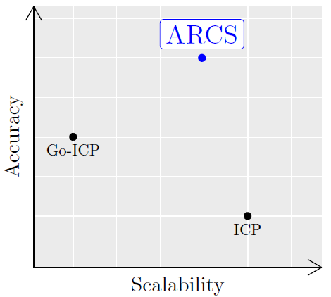
State of The Art
The ICP algorithm (and its variants)
+ preform well if adequately initialized
+ linear-logarithmic time complexity
- fails for most initializations
The Go-ICP algorithm (and its variants)
+ initialization-free
- exponential time complexity
Our algorithm: ARCS
+ initialization-free
+ linear-logarithmic time complexity
- rotation-only
Our Algorithm
ICP: P.J. Besl, N.D. McKay, “A Method for Registration of 3-D Shapes”. TPAMI 1992.
Go-ICP: J. Yang, H. Li, D. Campbell, Y. Jia, “Go-ICP: A Globally Optimal Solution to 3D ICP Point-Set Registration”, TPAMI 2016.

Slide 25
The ARCS Algorithm
ARCS consists of three steps:
Step 1: Establish Correspondences
Step 2: Outlier Removal
Step 3: Rotation Estimation/Refinement

Slide 26
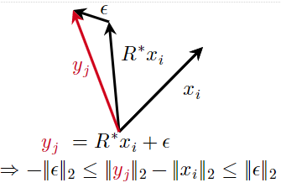
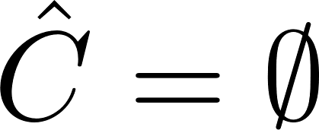
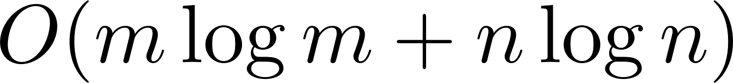
The ARCS Algorithm: Step 1
Step 1: Establish Correspondences
Initialization:
For every i=1,…,m, and j=1,…,n
Key Idea:
Step 1 can be implemented in linear-logarithmic time
Step 1 reduces the correspondence-less problem to Robust Rotation Search

Slide 27
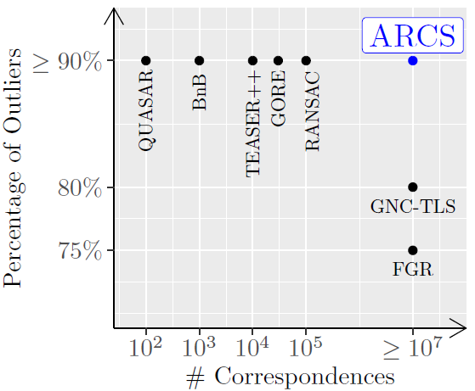

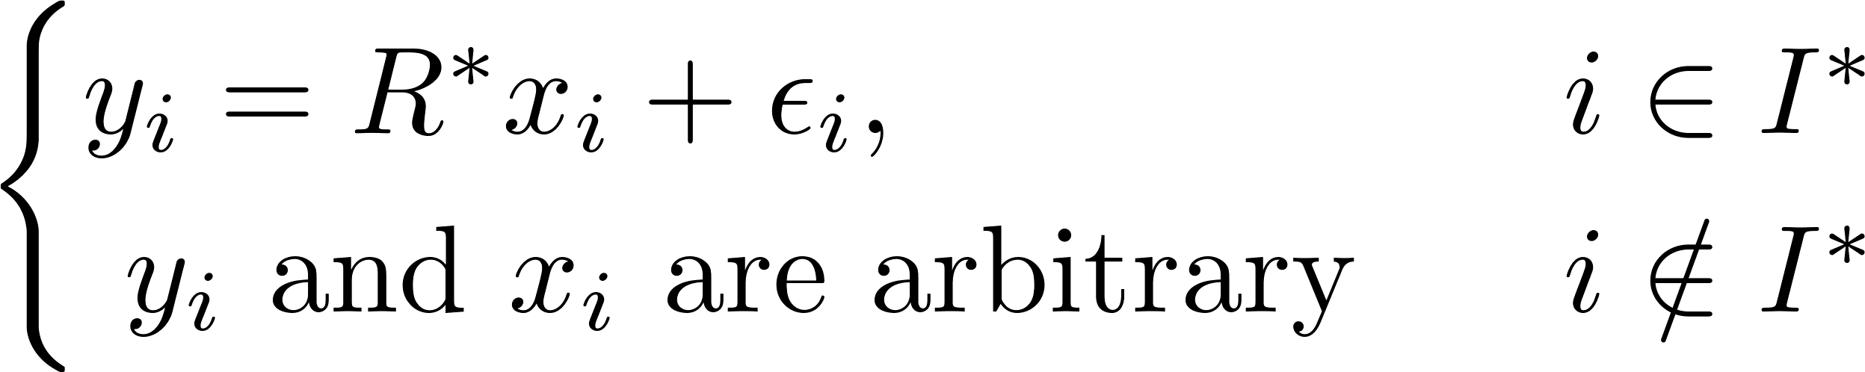
State of The Art
Our Solution (ARCS, Steps 2 and 3)
Robust Rotation Search Algorithms

Slide 28
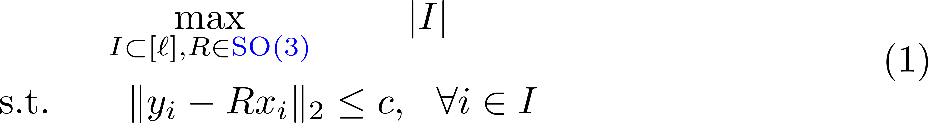
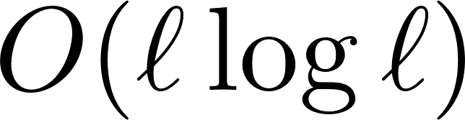
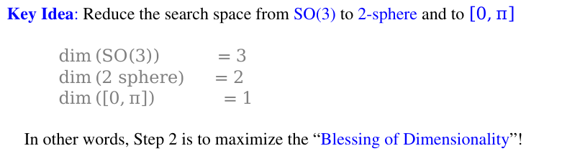
Step 2 of ARCS: Outlier Removal 1/2
Consensus Maximization: Maximize the size of the inlier set I
In general NP-hard [1] (any feasible point is a local minimizer)
Claim:
(1) can be solved approximately in linear-logarithmic time
Key Idea: Reduce the search space from SO(3) to 2-sphere and to $\left[0,π\right]$
$\dim\left(SO\left(3\right)\right) =3$
$\dim\left(2 sphere\right) =2$
$\dim\left(\left[0,π\right]\right) =1$
In other words, Step 2 is to maximize the “Blessing of Dimensionality”!
[1]: T. Chin, Z. Cai, F. Neumann, Robust Fitting in Computer Vision:
Easy or Hard?, IJCV 2020

Slide 29
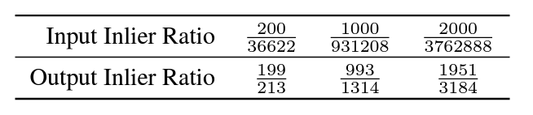
Step 2 of ARCS: Outlier Removal 2/2
Performance of Step 2
More than 3 million outlier point pairs are removed!
The final step:
Refine the rotation on the remaining point pairs
In the paper, we consider random, non-adversarial outliers

Slide 30
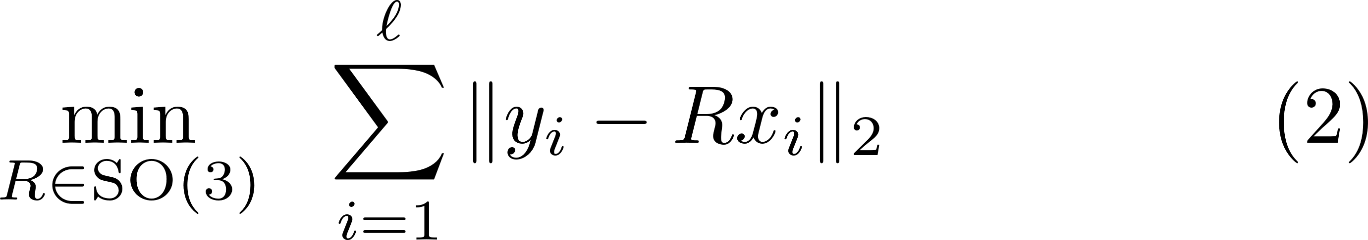
Step 3 of ARCS: Rotation Refinement 1/3
“Sum of Unsquared Deviations”:
Non-Convex (due to the constraint)
Non-Smooth (due to the objective)
The First Thought:
Riemannian Subgradient Descent
Problem: hard to derive theoretical guarantees
E.g., SO(3) has a determinant constraint

Slide 31
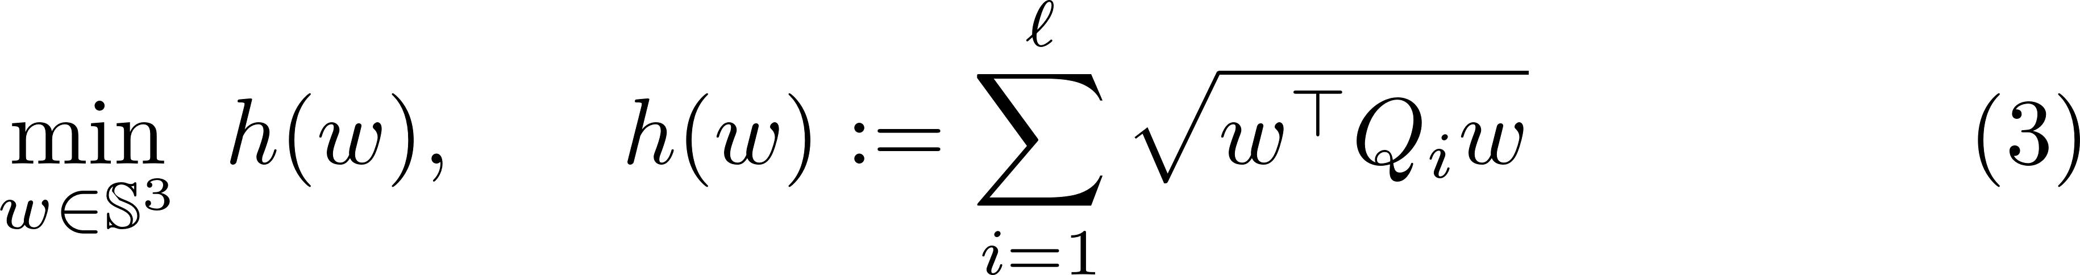
Step 3 of ARCS: Rotation Refinement 2/3
“Sum of Unsquared Deviations”:
Non-Convex (due to the constraint)
Non-Smooth (due to the objective)
The Second Thought:
Riemannian Subgradient Descent on Unit Quaternions
Claim: (2) is equivalent to

Slide 32
Step 3 of ARCS: Rotation Refinement 3/3
“Sum of Unsquared Deviations”:
Non-Convex (due to the constraint)
Non-Smooth (due to the objective)
The Final Algorithm:
Claim: Under certain regularity conditions, the algorithm converges locally at a linear rate, e.g.,

Slide 33
ARCS: Scalability & Accuracy in Numbers
ARCS is correspondence-free and can handle:
more than a million points with 2 overlapping points without noise
roughly ten thousand points with 20% overlaps under small noise
ARCS (Steps 2 and 3) can handle:
ten million point pairs with 0.03% inliers
See our paper for more formal experimental report.

Slide 34
Future Works (Part II)
Extend ARCS to the rotation + translation case
A trivial extension is in the appendix of our paper
Need a smarter and more scalable extension
Feature learning from point clouds for registration
Desiderata
It should be scalable
Should it learn differential-geometric invariance of 3D shapes？
Should it be interpretable by design? (Aditya)
Supervised:
Query a point pair, answer whether it is inlier or outlier
(Unsupervised):
Query a point pair, compute the probability of this pair being an inlier

